Slide 1
Software Engineering Project
AMIGO

Slide 2
Project no - 55
Group Members -
Rahul Roy - IIT2019194
Nischay Nagar - IIT2019198
Eshan Vaid - IIT2019230
Ayush Khandelwal - IIT2019240

Slide 3
Problem Statement
Develop an Academic management system (AMS) from HoD/Coordinator’s and FnA perspective in IIITA.
Description :
Considering the scenario of IIITA, in this project you are required to develop an AMS application that offers a user friendly interface for management of academic affairs (Admissions, Assessments, Awards and Archives)
User authentication is done using a LDAP server.
System administrator enables/disables user account of LDAP server for access to AMS.

Slide 4
Goals of our project
There is a great issue of selecting course, managing them ,managing and assignment of teachers and course coordinator if done by hands and in the present time where everyone is so far away from each other and the administration building . Automation and using an online system for all these work would be a great time reduser and reduce mess of all the management of papers and the management of information. Also as the users are restricted to see only the data they are allowed to, this system will even help in reduce in misuse of information and power.
So the goal is to reduce the manual management labour, and bring a sense of interactions among students and administration despite of the physical distance from each other.

Slide 5
FROM STUDENTS POINT OF VIEW
. Student’s find it difficult to complete the registration and admission process as on the day of admission, many students arrive at the spot at the same time which makes it difficult, slow and less efficient procedure.
. Students want a platform where they can know the admission related procedure in advance so that it does not get complicated on the day of registration.
. All institution holidays, institute calendar and course details must be provided in a simple and structured way to students.

Slide 6
AIM AND PURPOSE
“Amigo” is basically a web application that offers a user friendly interface for management of academic affairs (Admissions, Assessments, Awards and Archives).
The process of admission and academic management of our institution is less efficient and clumsy in our organisation (NU), as per one of the spokesperson from the Academic Department. Hence we aim to create a platform for smooth, easy and efficient interaction between the students, academic administration and FnA.

Slide 7
FROM ACADEMIC STAFF’S POINT OF VIEW
. The academic management gets a heavy load of work on the day of admission, due to simultaneous registration processes taking place.
. They want a platform to provide information regarding the institution calendar, events and more to all the students without worrying about any future updates, reschedulement and cancelation.
So, this project is an attempt to overcome these drawbacks in IIIT Allahabad.

Slide 8
Motivation
There are still many institutions where the management of such things like course management, student record management , etc, takes place manually which consume lots of
Time,
Energy,
Human efforts and
Physical space.
Creating and implementing something meaningful which can solve the real life problem and can be used on daily basis across the globe could could be really helpful to all the institutions.
Making all the system electronic and interconnected makes it easy for each use case to handle their responsibilities more efficiently.

Slide 9
Application of AMIGO
This Application can be used for many different types of uses like presently the course allocation, course coordinator allocation, teacher management , calendar management, fees regulation, fee approval , etc. and could even be modified for many other purposes according to he use like hostel room registration, mess fee payment etc.
AMIGO has simple and user friendly interface which can be used by anyone ,anywhere.It is a tool that would save a lots of human efforts and that efforts and time could be used in more productive things, increasing productivity of institution as well as reducing workload on teachers, FnA, HoDs ,etc.
This application could be used in any device having a stable internet connection from all over the world at anytime, so there is no collision between timing of people from different time zones. A person dont needs to wait for the administration to accept the fees or student to select course or HoD to maintain the course,the could be flexible according to their own lifecycle.

Slide 10
AMS offers following Use cases to the HoD/Coordinator:
Profile view (Personnel details) and request for modifications if any
Academic calendar display
Faculty list management
Creation/updation of courses (Core, Elective)
Batch-wise, program-wise, semester-wise allotment of courses
Core
Elective portal management
Project portal management (Summer internship/master projects)
Batch-wise, program-wise, semester-wise course registration status
Class time-table upload and display
Exam schedule upload and display
Appointment/update of course coordinator
Notice board management
General messages / notifications based on event

Slide 11
AMS offers following Use cases to the FnA:
Fees chart management
Fees payment status at the time of admission
Fees payment status at the time of registration
Fees approve/disapprove
Fees waiver status
Defaulters list display
Special permission granted for delayed payment of fees
Re-conciliation of fees

Slide 12
Challenges AMIGO overcomes
Challenges that could be overcame with the help of AMIGO are:
Physical storage of information at the time of admission, course registration(every semester), coordinator allocation , course management, fees management,etc.
Human efforts to cross check information according to the use like while comparing names in documents, issuing official documents like ID cards, previous and present course management, and many other places.
Time collision as sometimes it’s not in the hand of person to be present at a particular place and time like for registration of courses a student could do it any time according to his convenience from anywhere, or HoD being flexible to manage the courses and teachers any time. So basically removing the constraint of time and place.

Slide 13
Challenges faced while making AMIGO
Challenges that we faced while making AMIGO are:
Access provision of different type of data was one of the challenges we faced. Not all users are allowed to access and update all the type of data which could be overcome by multi level authentication.
Multi level authentication was another challenge and overcame with the help of selection of type of user before hand.
Setting up initial passwords for the new students. So we took up something that is not known to all, i.e. , Date of birth as initial password and then we gave an option to change it as soon as they get their account.
Setting profile picture individually could be tedious for administration, so initially they don’t have one and could be added and replaced anytime and from anywhere.

Slide 14
Requirements
Hardware Interfaces
All the hardware on which a Web Browser can be installed can act as an interface for the product and the user. The Hardware can be mobile, laptop, pc and tablet.
Software Interfaces
All the software required for a Web Browser needs to be installed and act as an interface for the product and the user.
Communications Interfaces
The communication between the different parts of the system is important since they depend on each other. However, in what way the communication is achieved is not important for the system and is therefore handled by the underlying operating systems for web application. But, any transaction on the web deals with the following protocols.
TCP/IP
HTTP

Slide 15
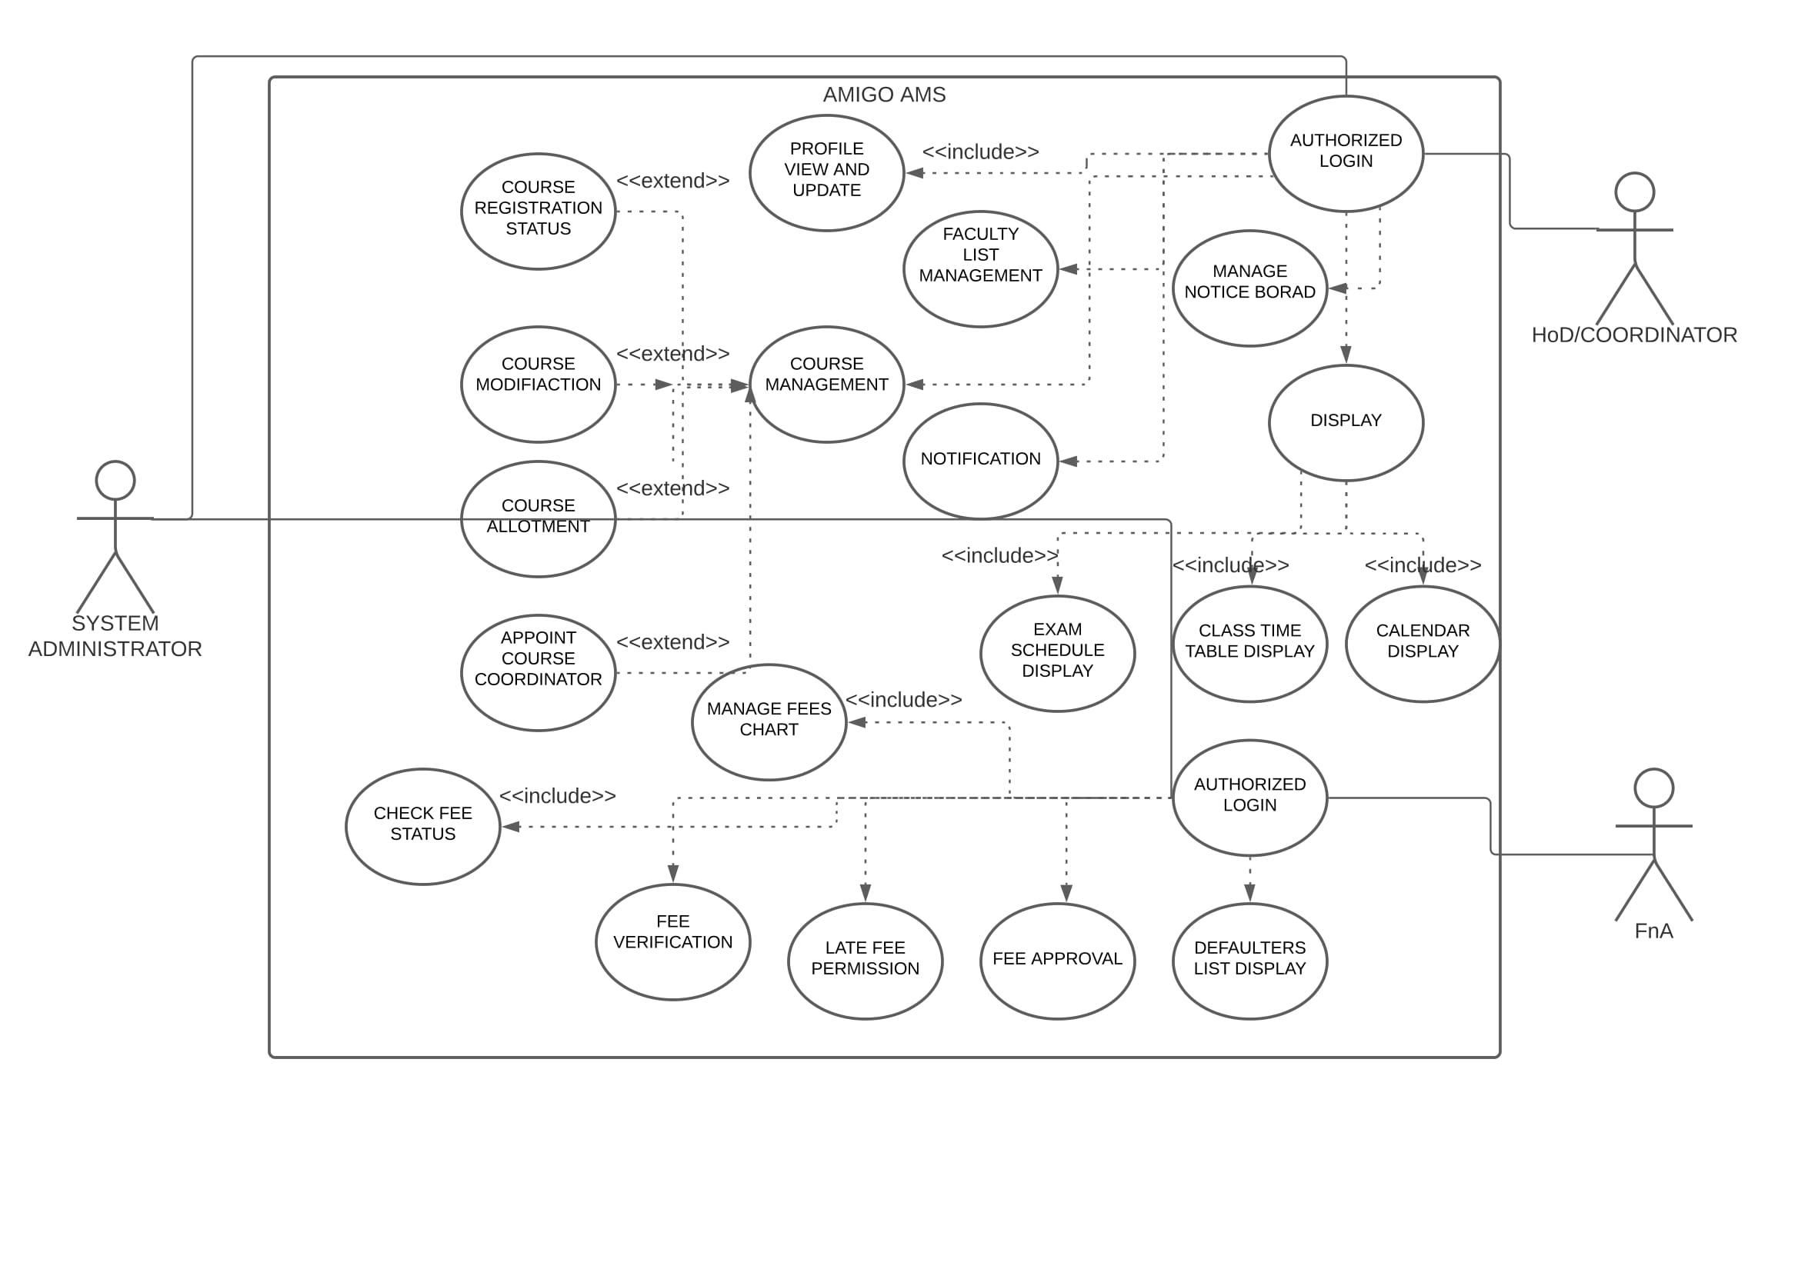

Slide 16


Slide 17
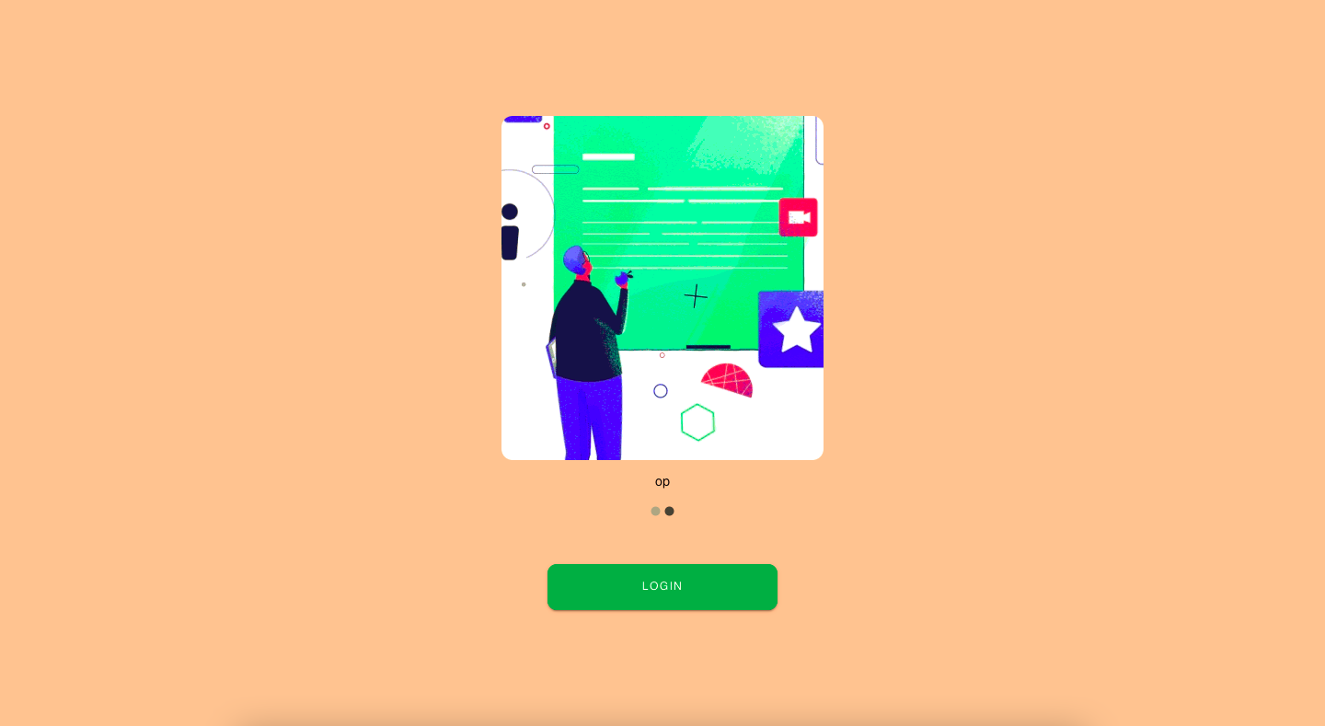

Slide 18
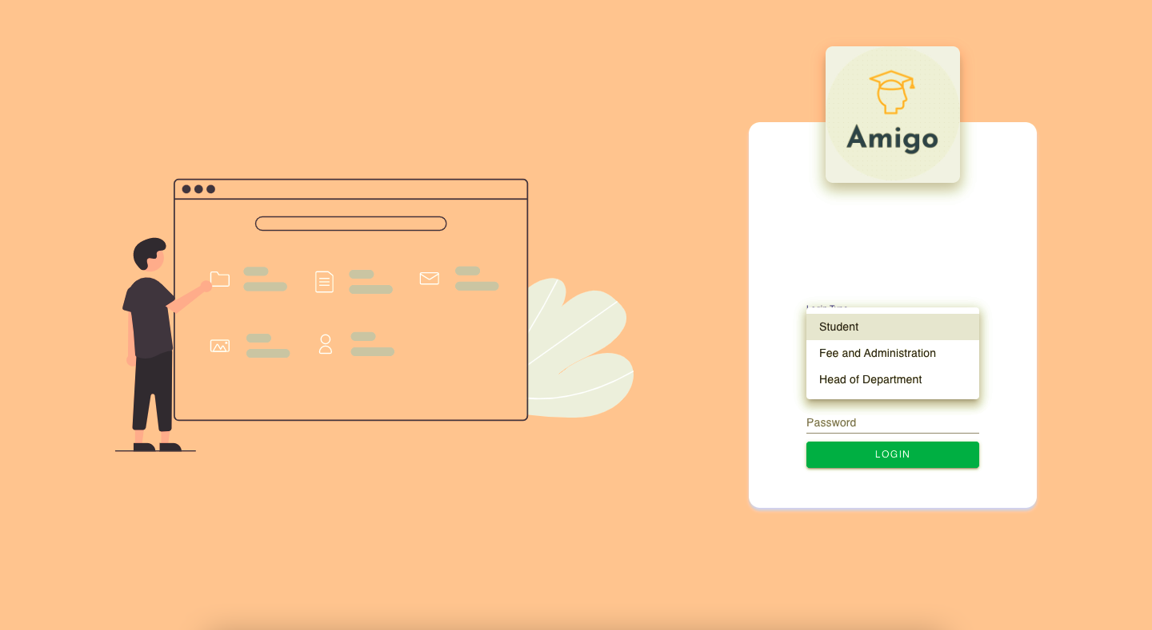

Slide 19
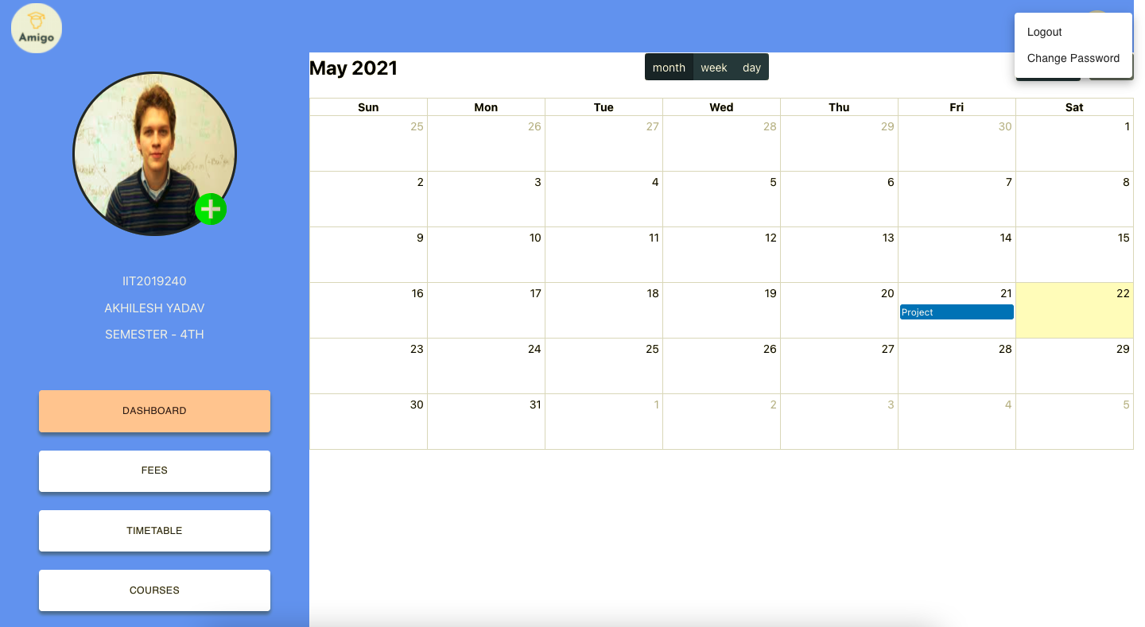

Slide 20
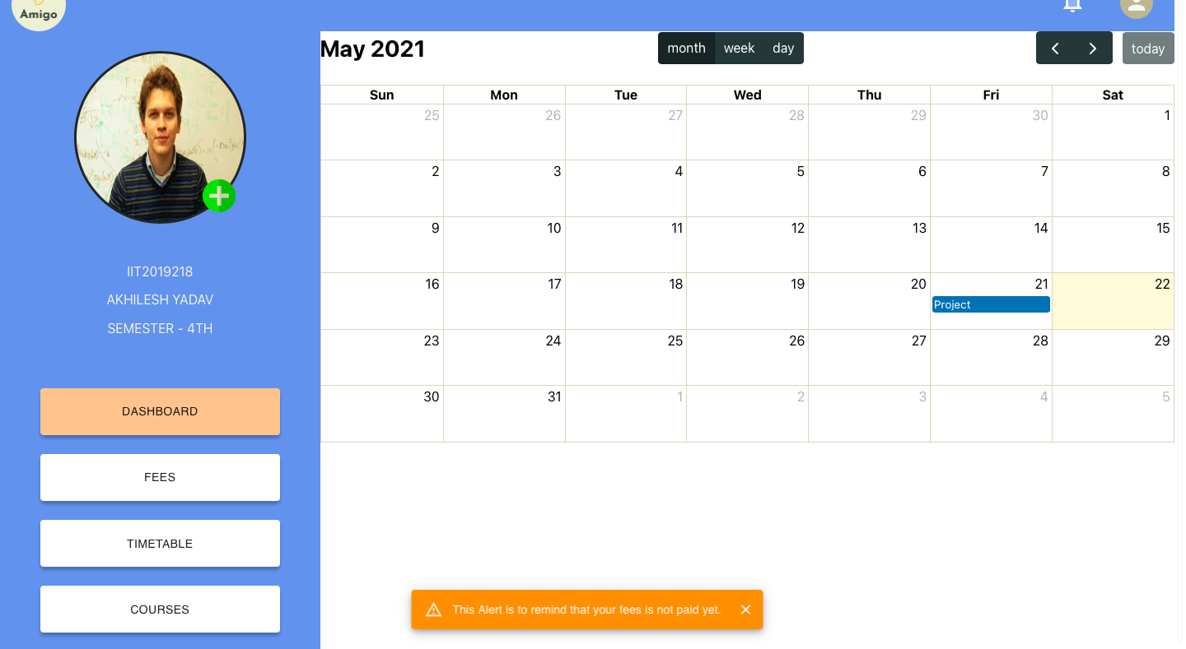

Slide 21
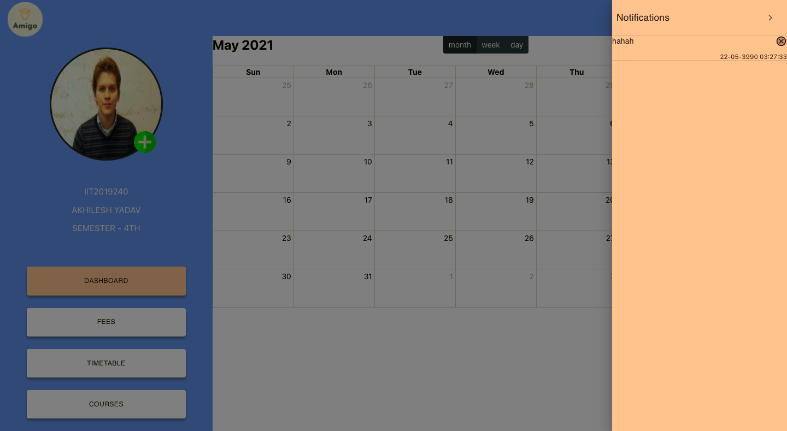

Slide 22
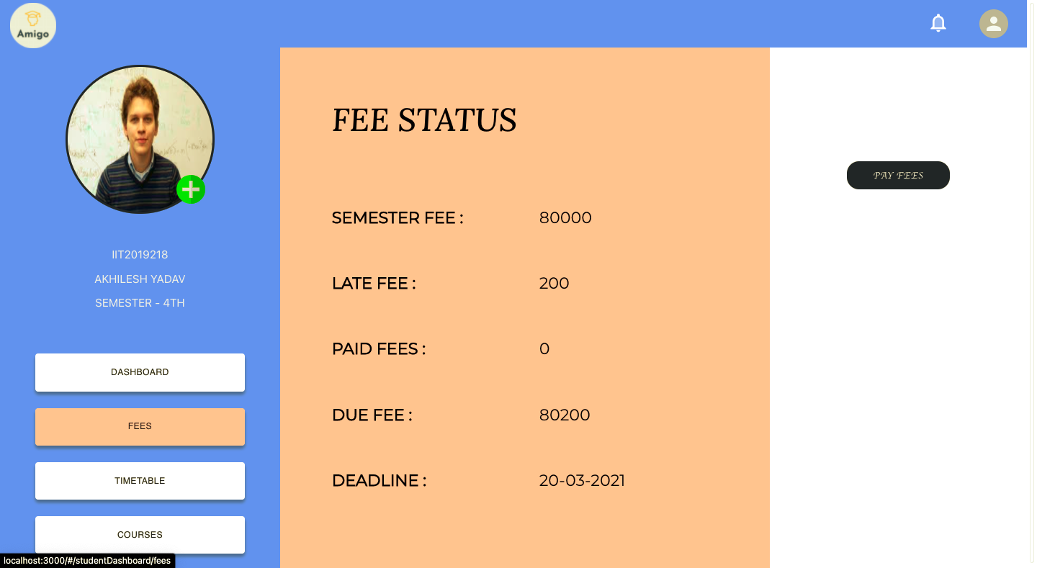

Slide 23
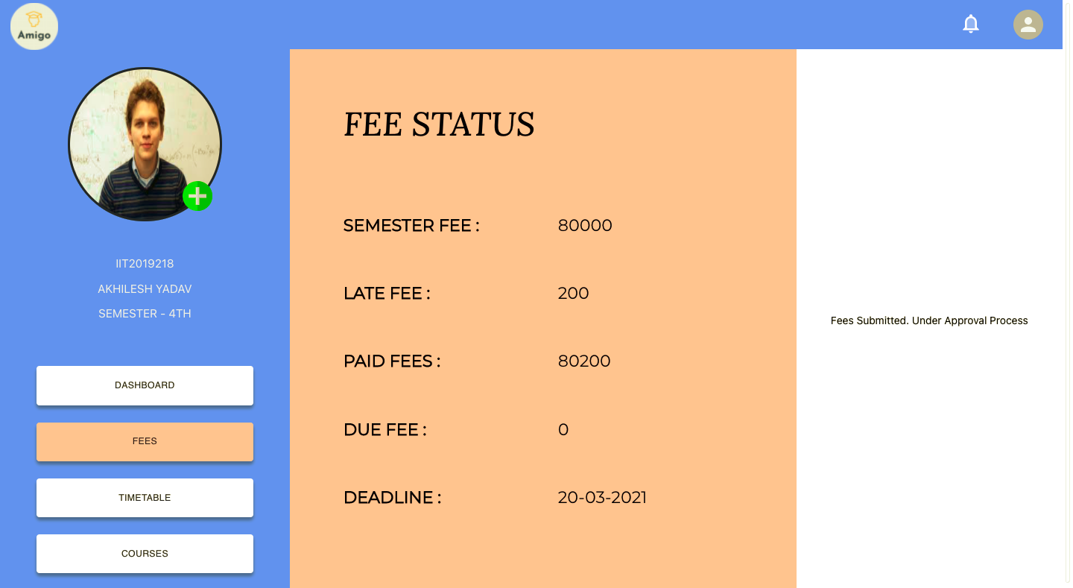

Slide 24
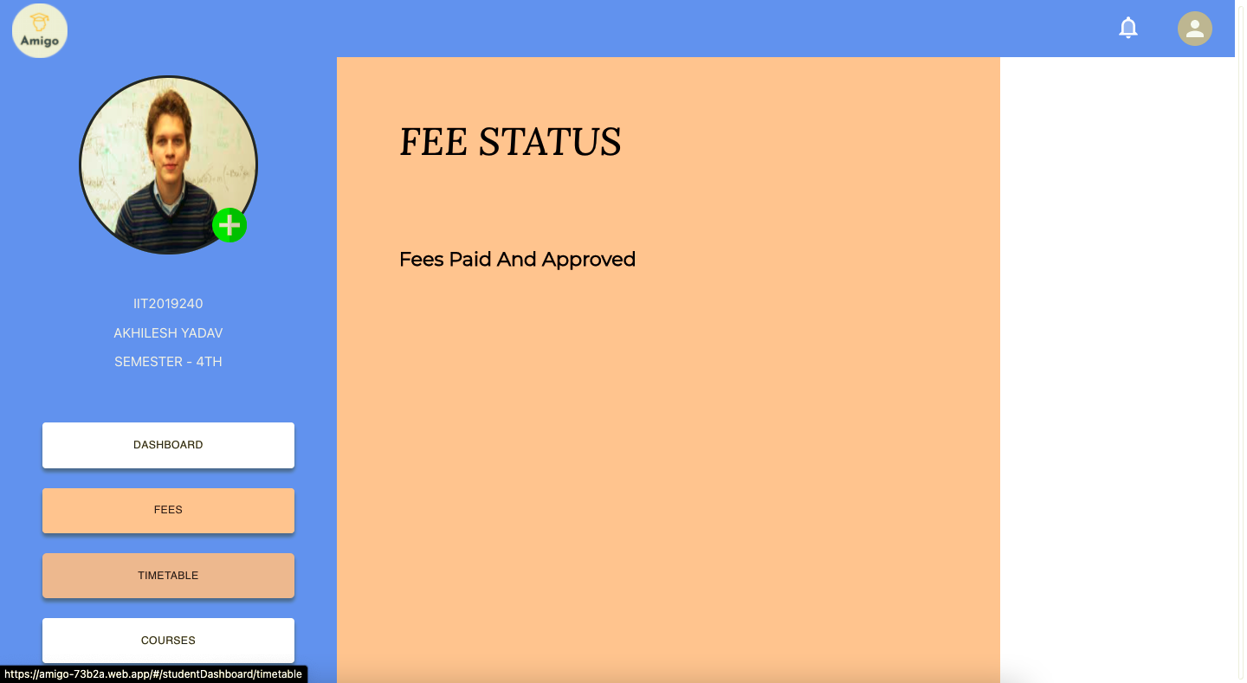

Slide 25
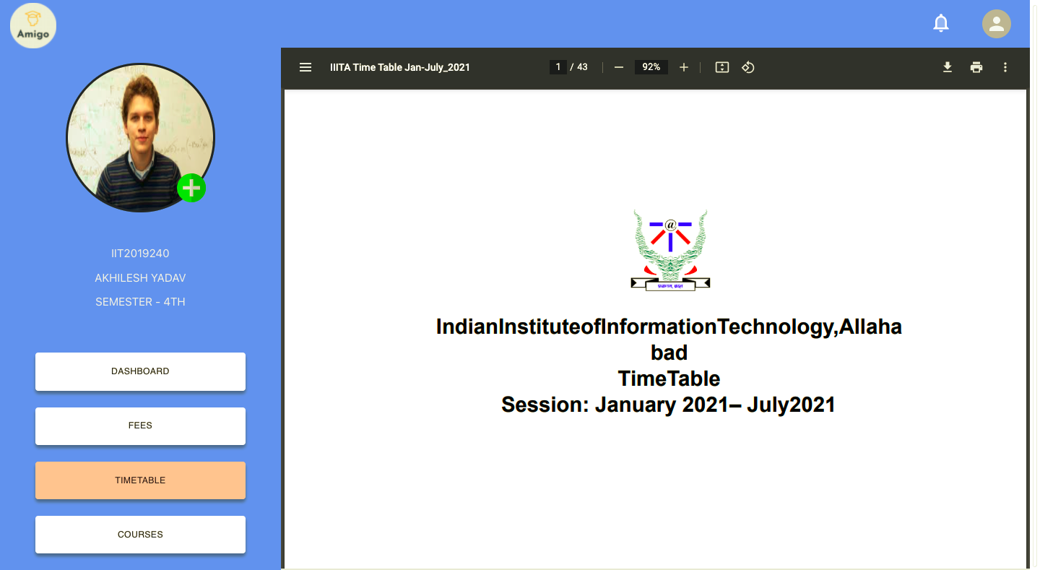

Slide 26
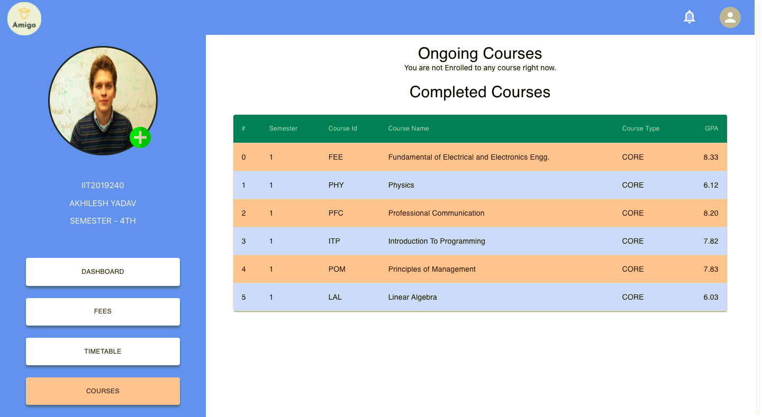

Slide 27
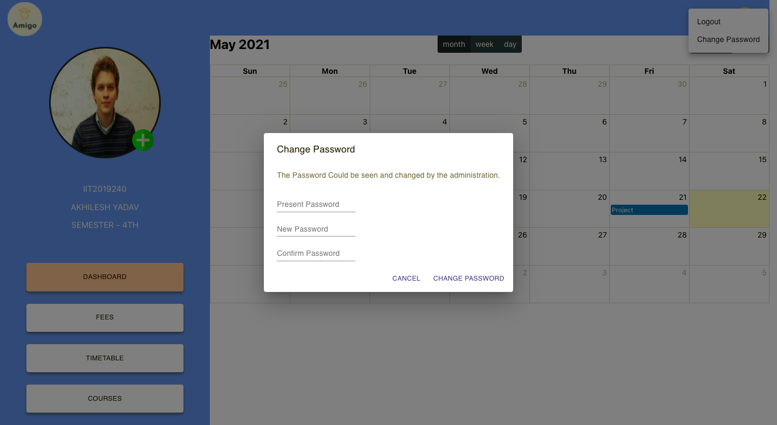

Slide 28
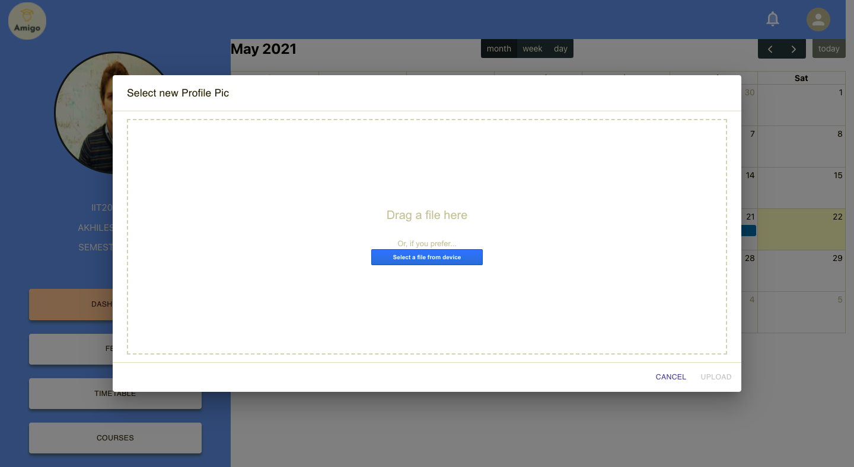

Slide 29
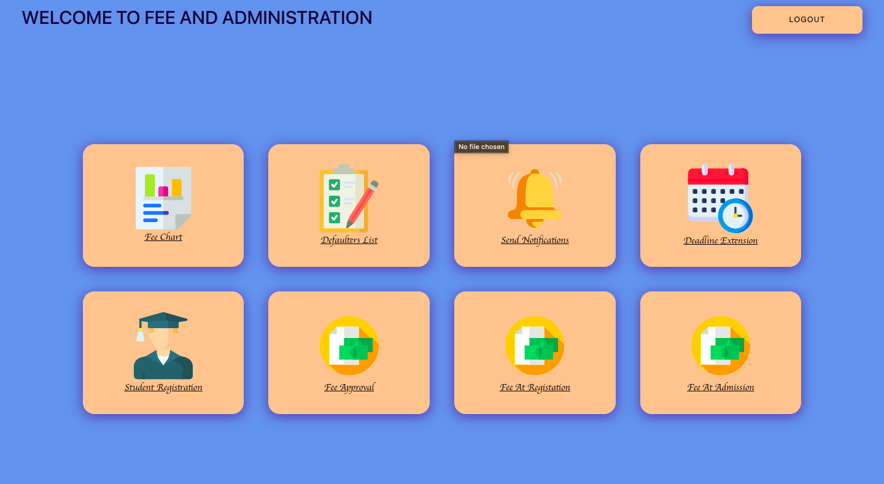

Slide 30
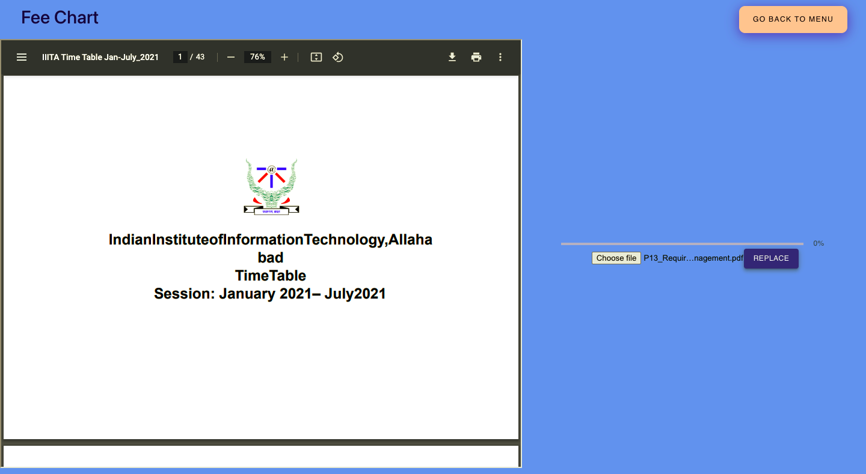

Slide 31
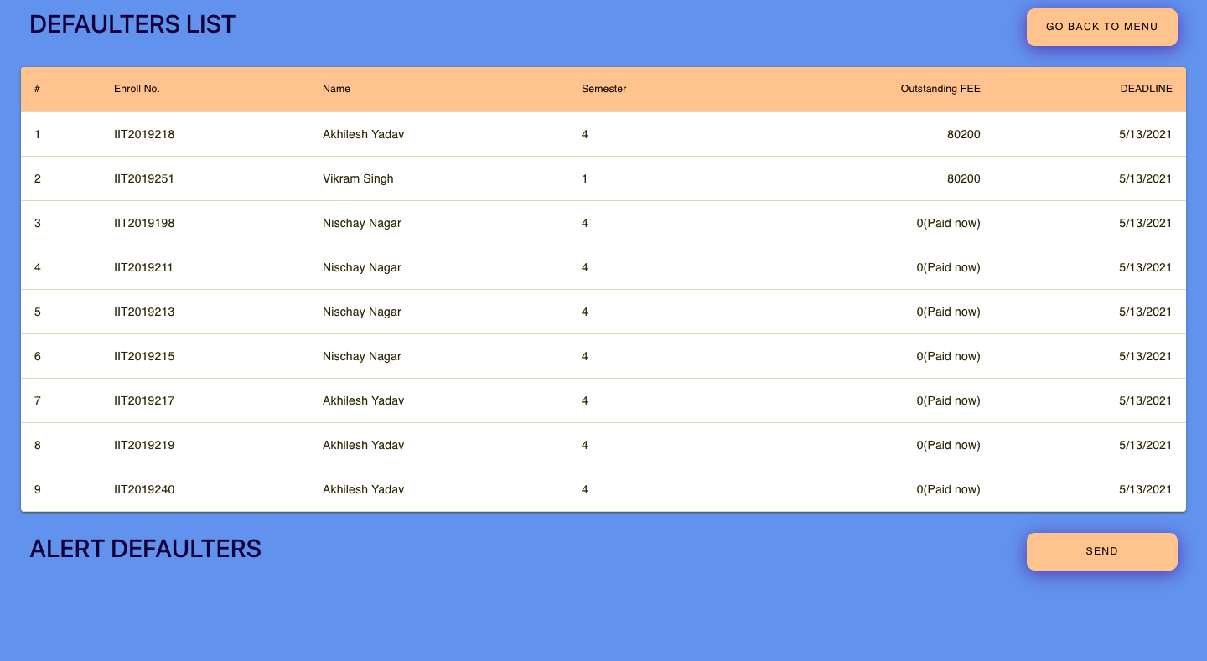

Slide 32
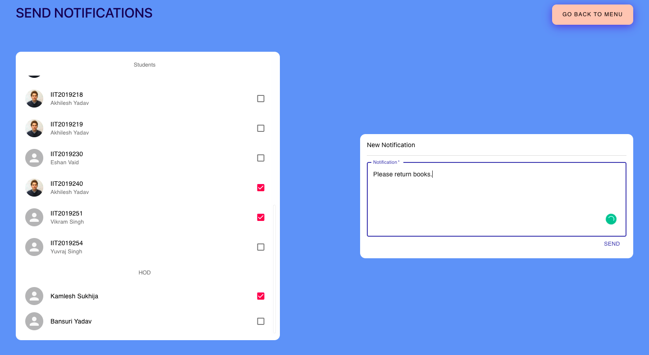

Slide 33
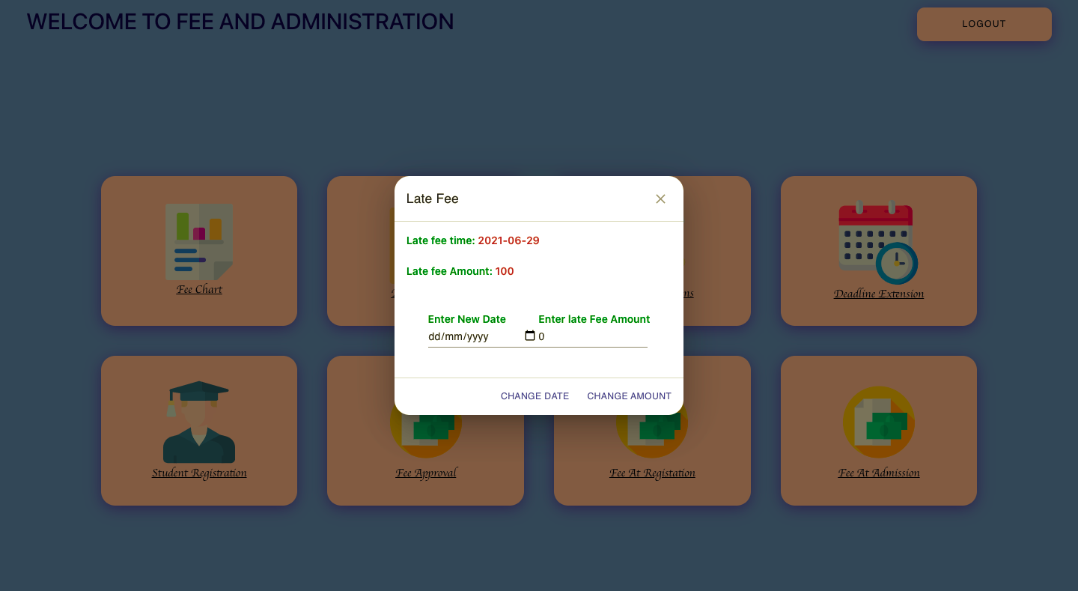

Slide 34
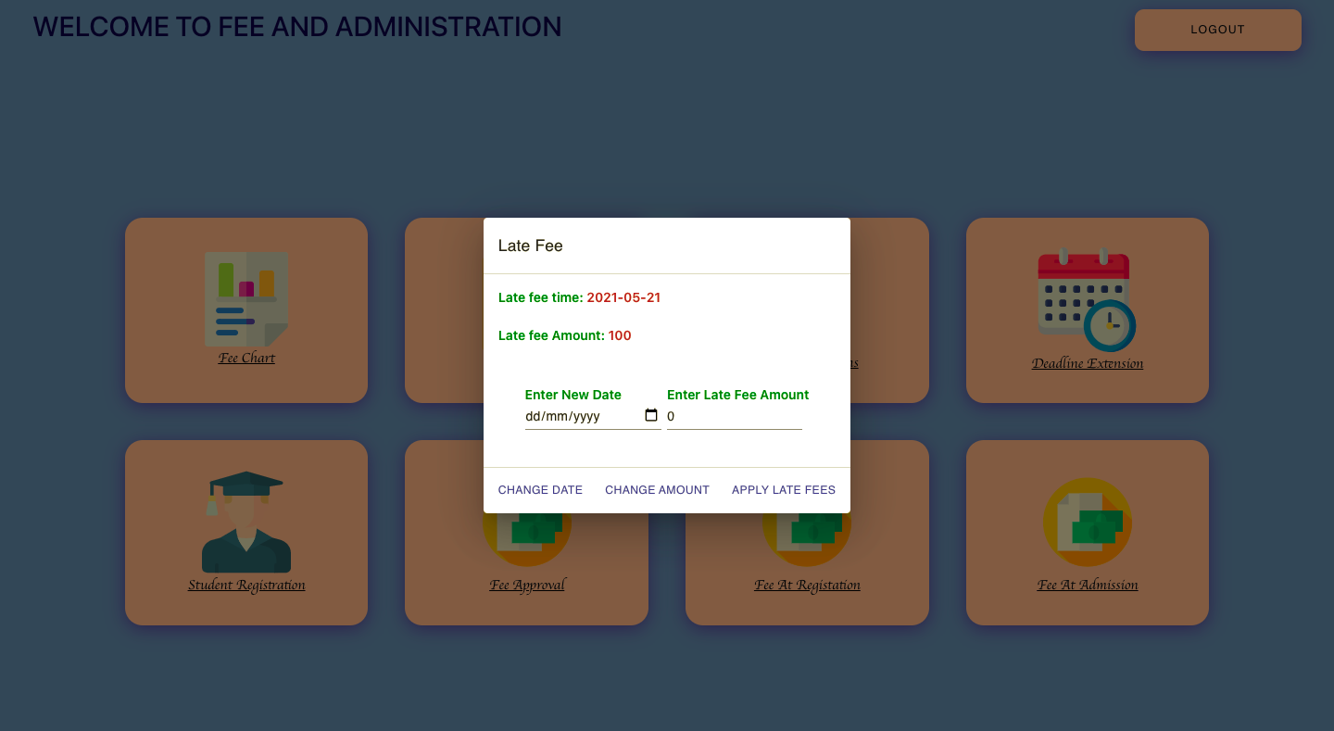

Slide 35
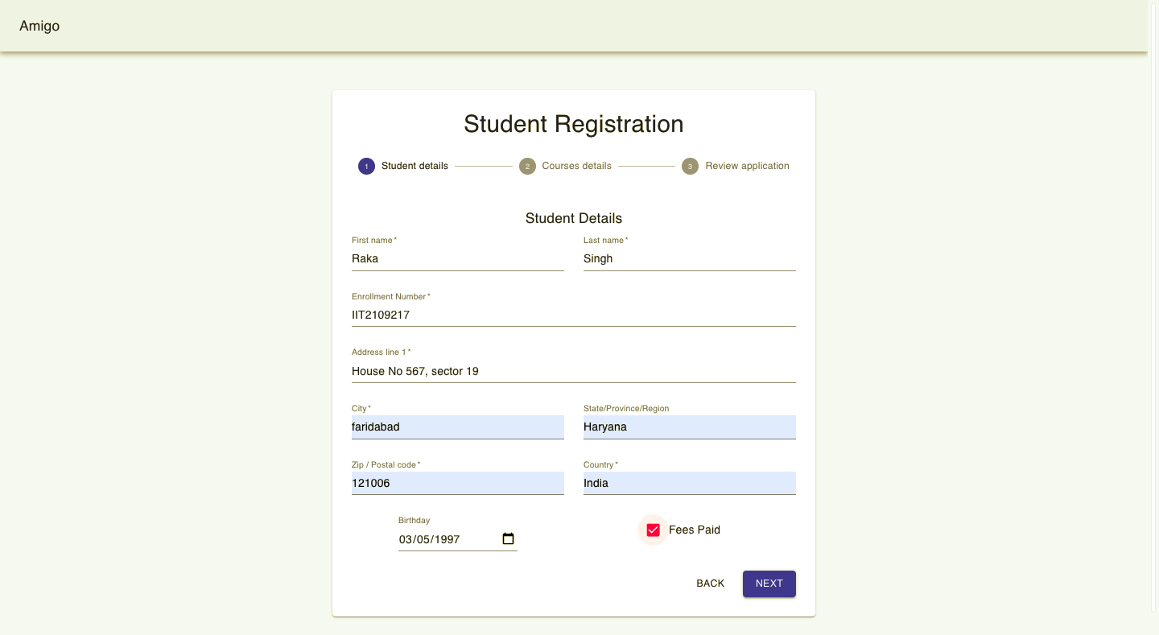

Slide 36
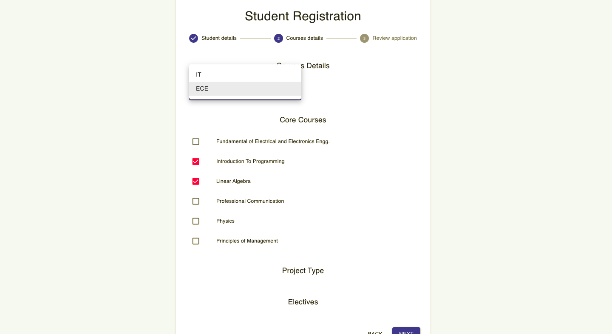

Slide 37
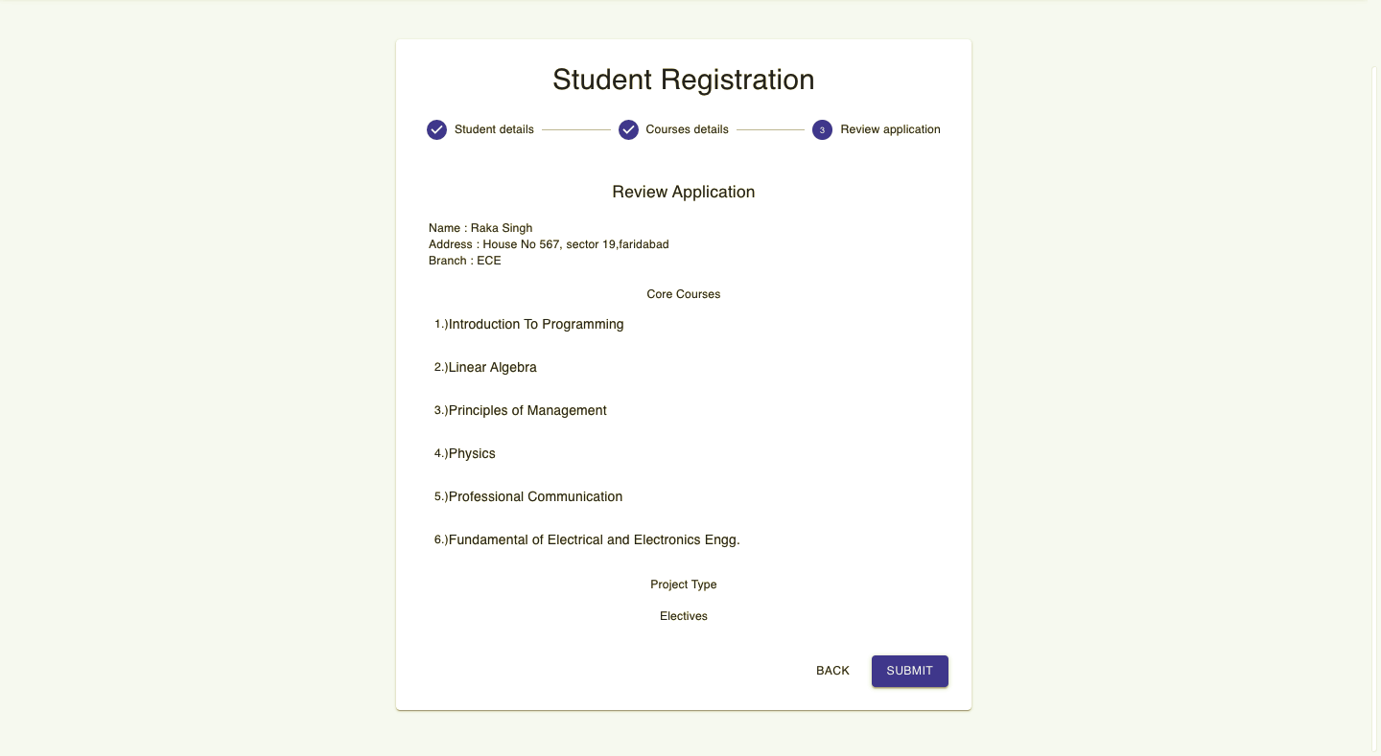

Slide 38
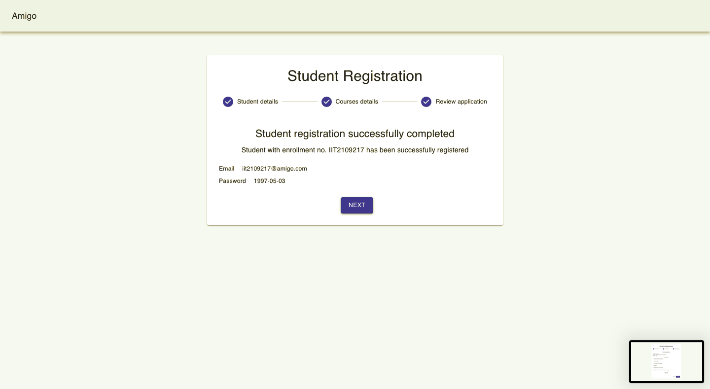

Slide 39
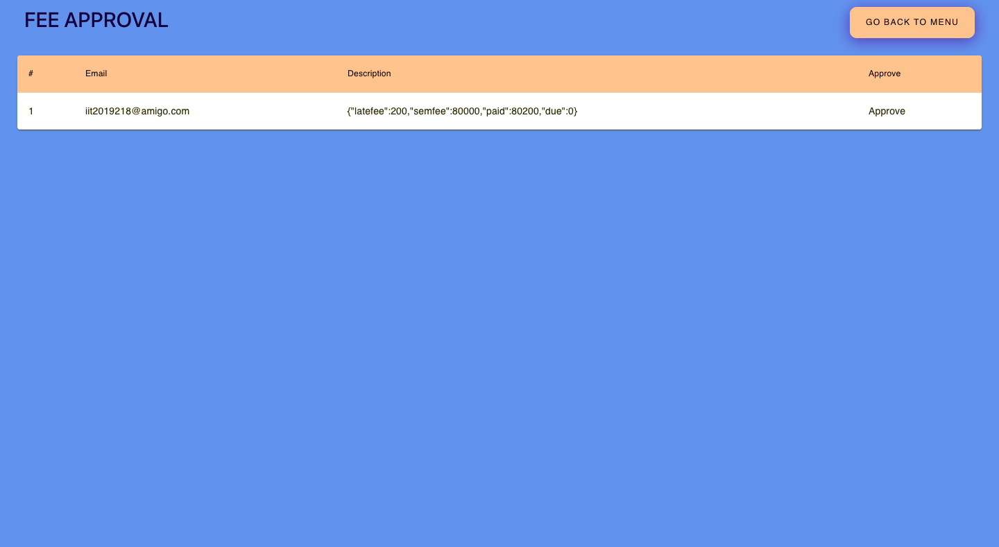

Slide 40
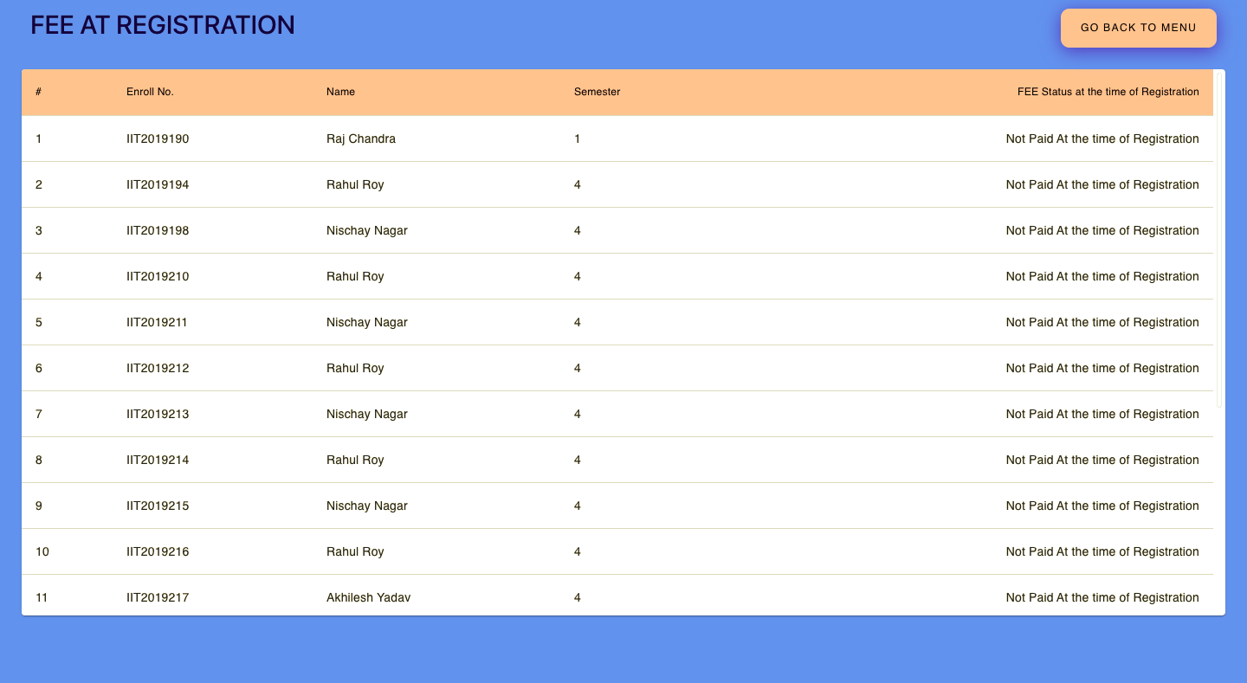

Slide 41
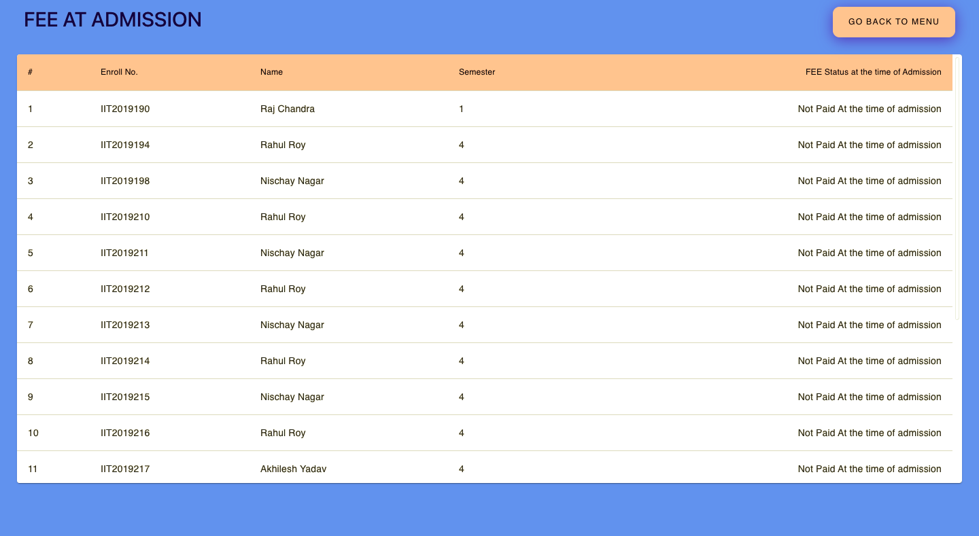

Slide 42
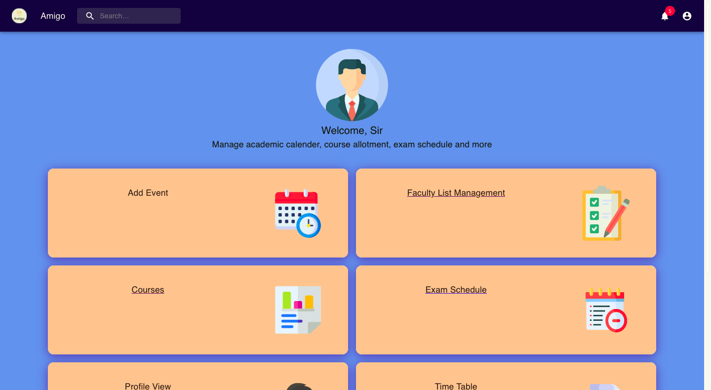

Slide 43
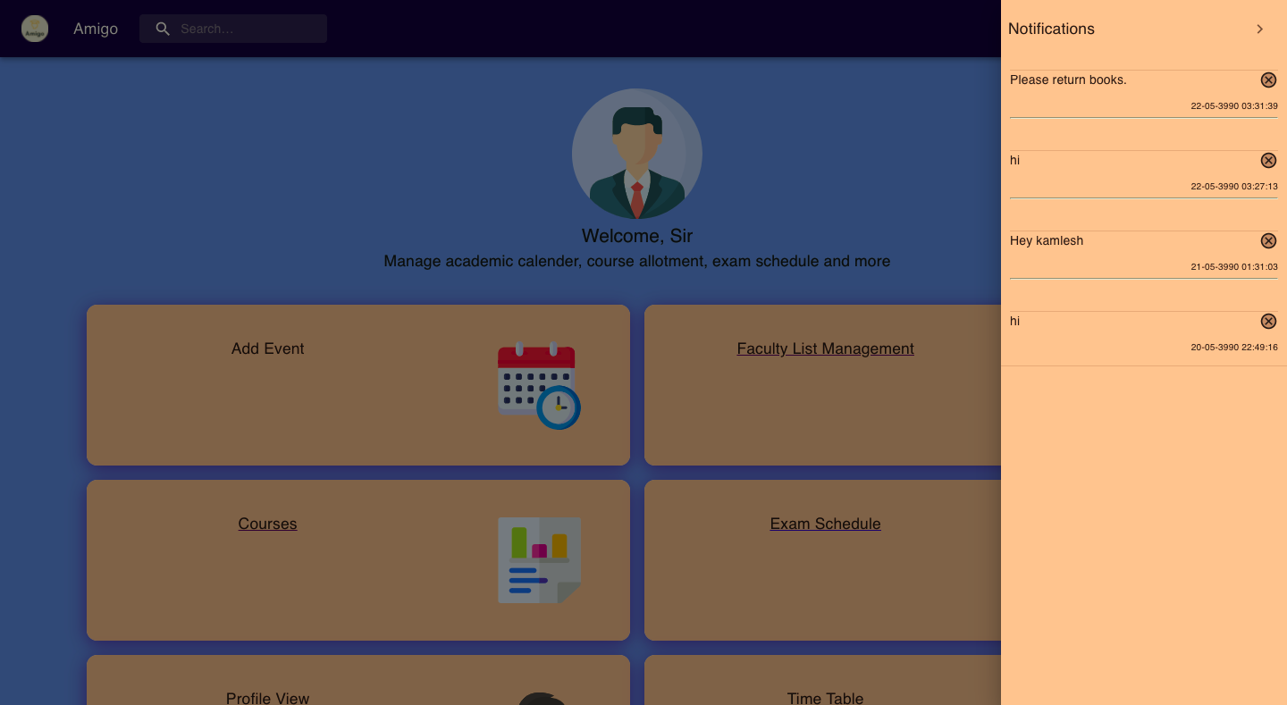

Slide 44
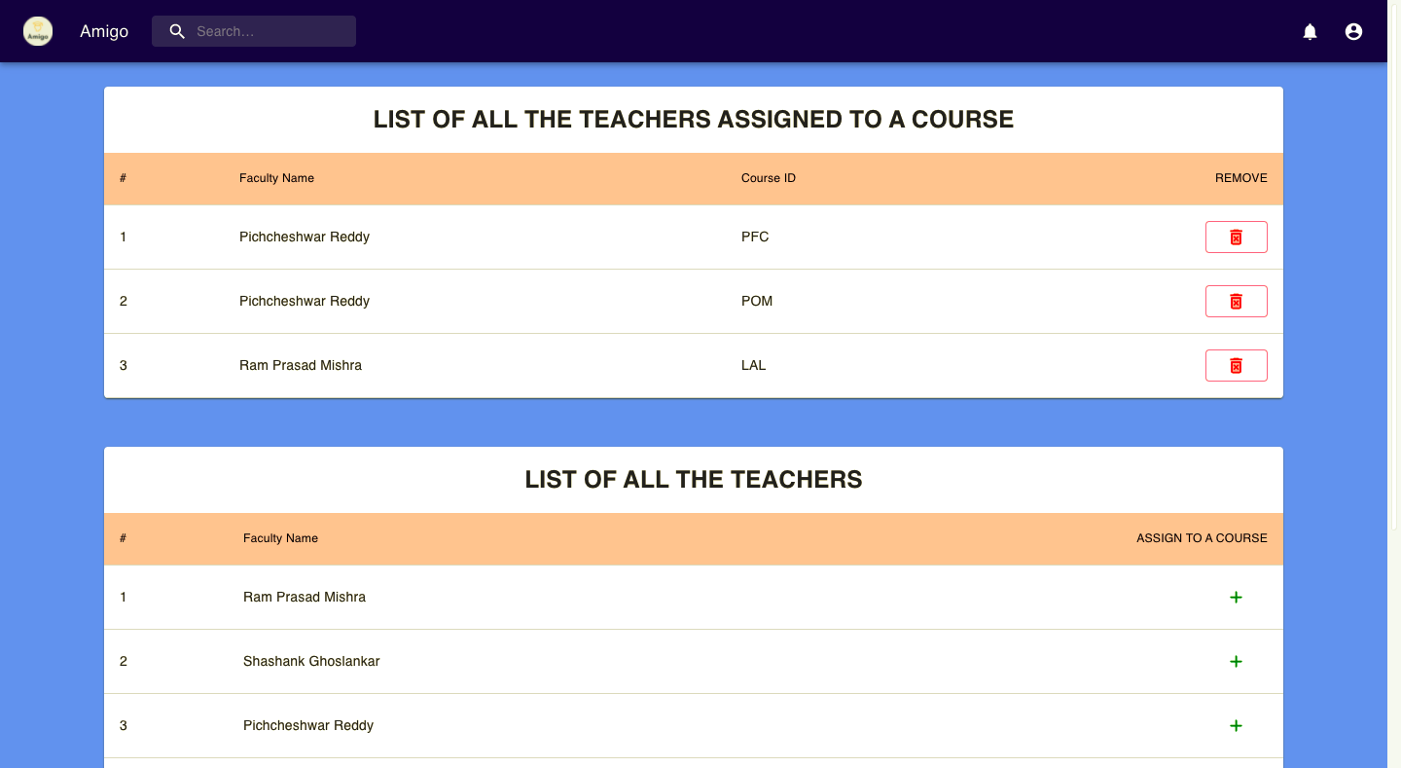

Slide 45
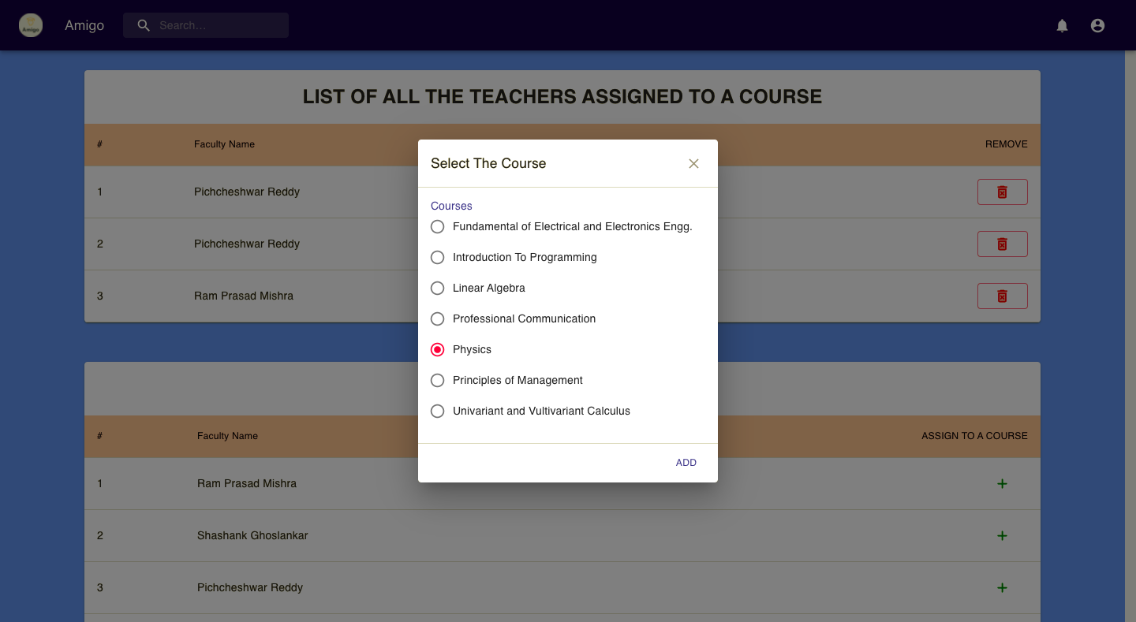

Slide 46
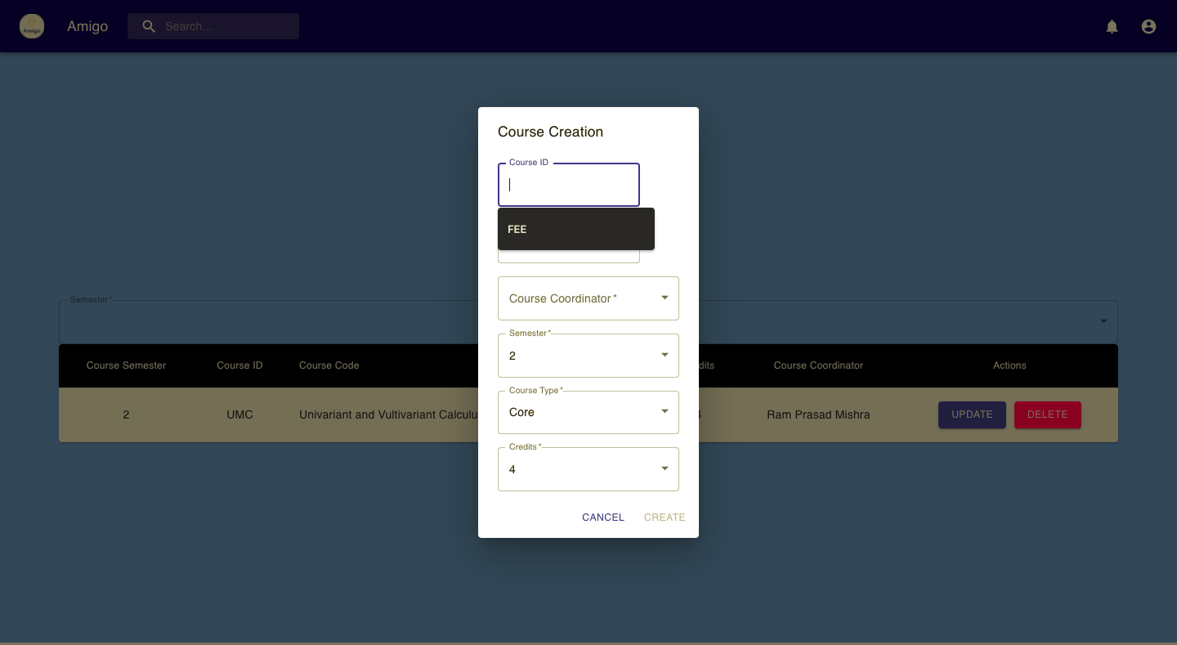

Slide 47
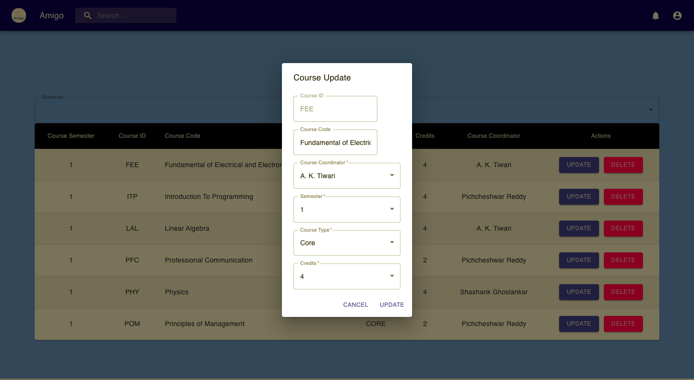

Slide 48
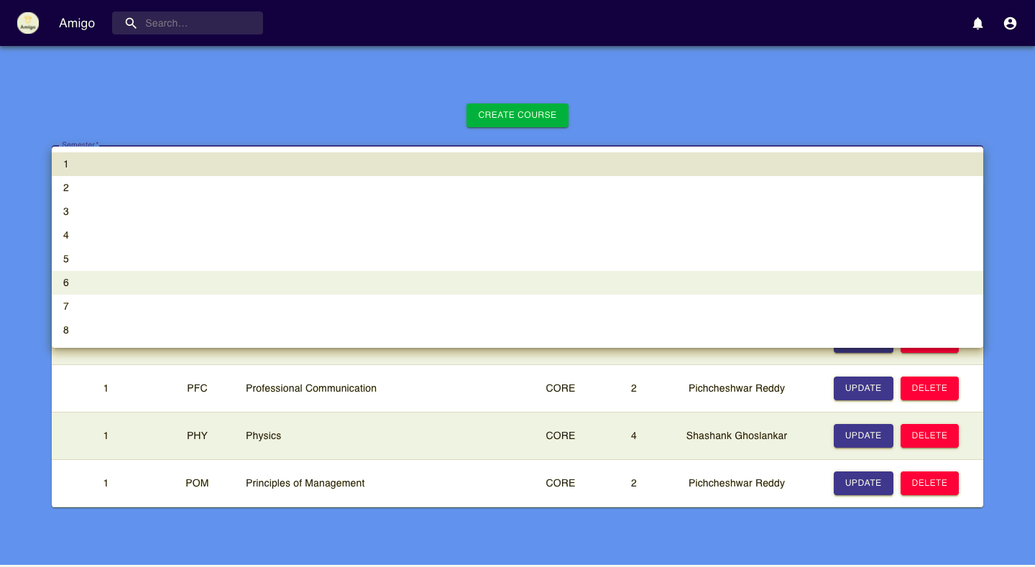

Slide 49
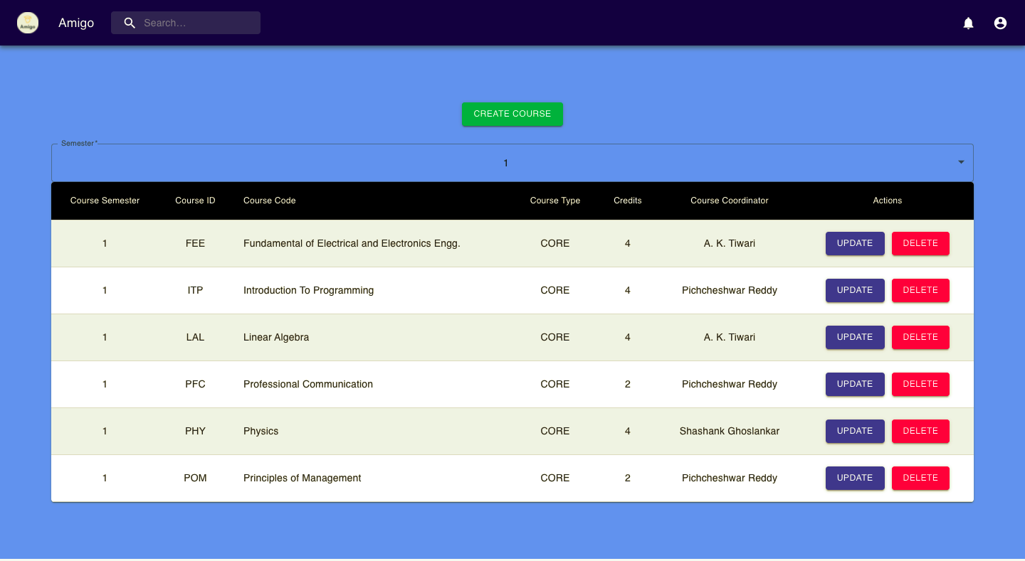

Slide 50
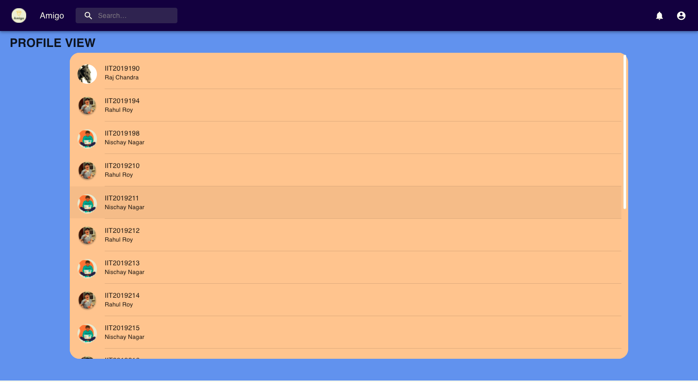

Slide 51
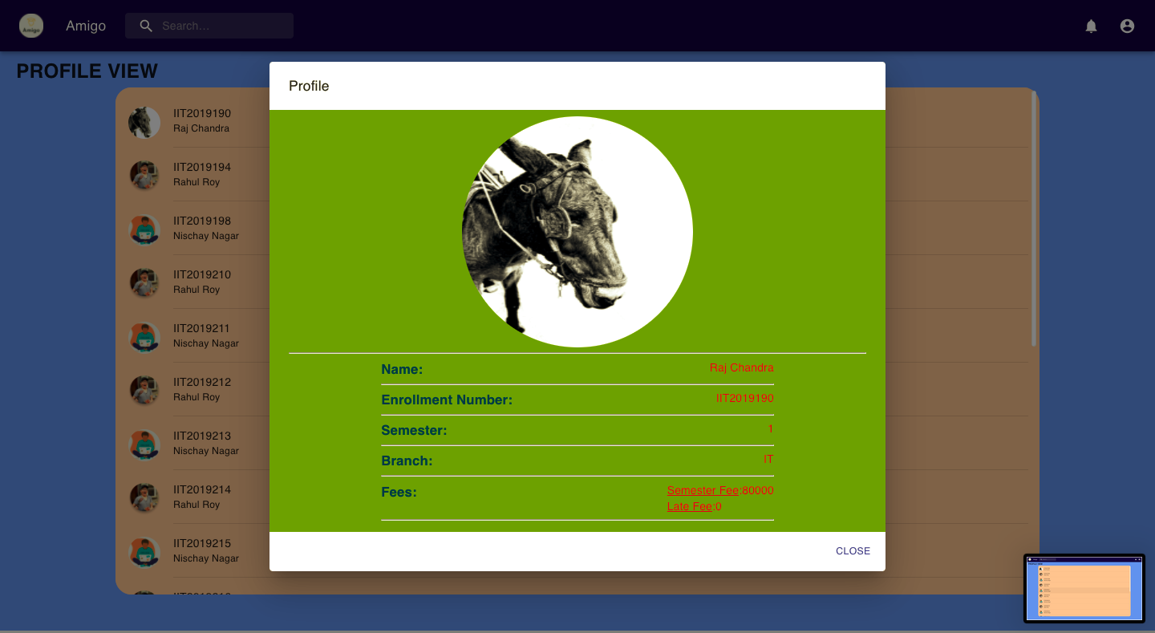

Slide 52
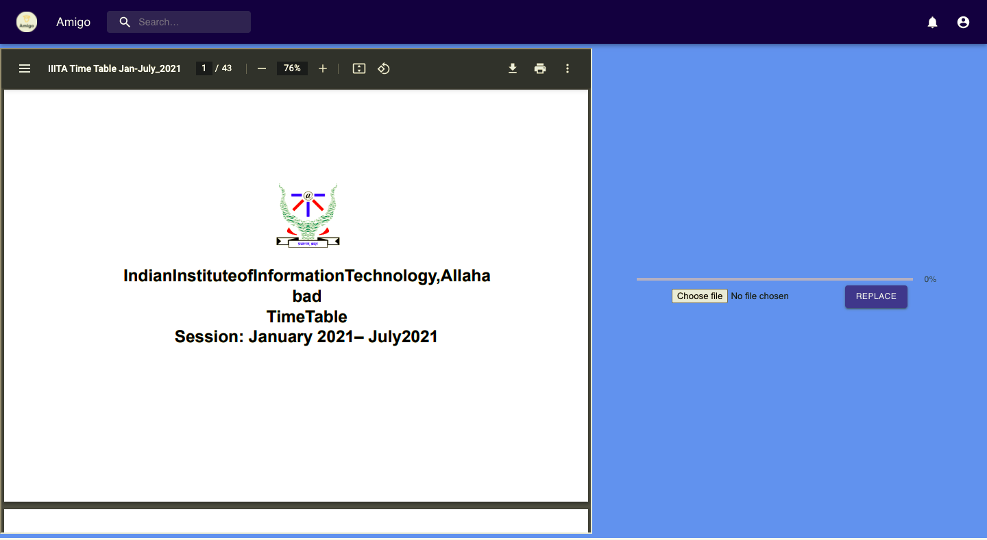

Slide 53
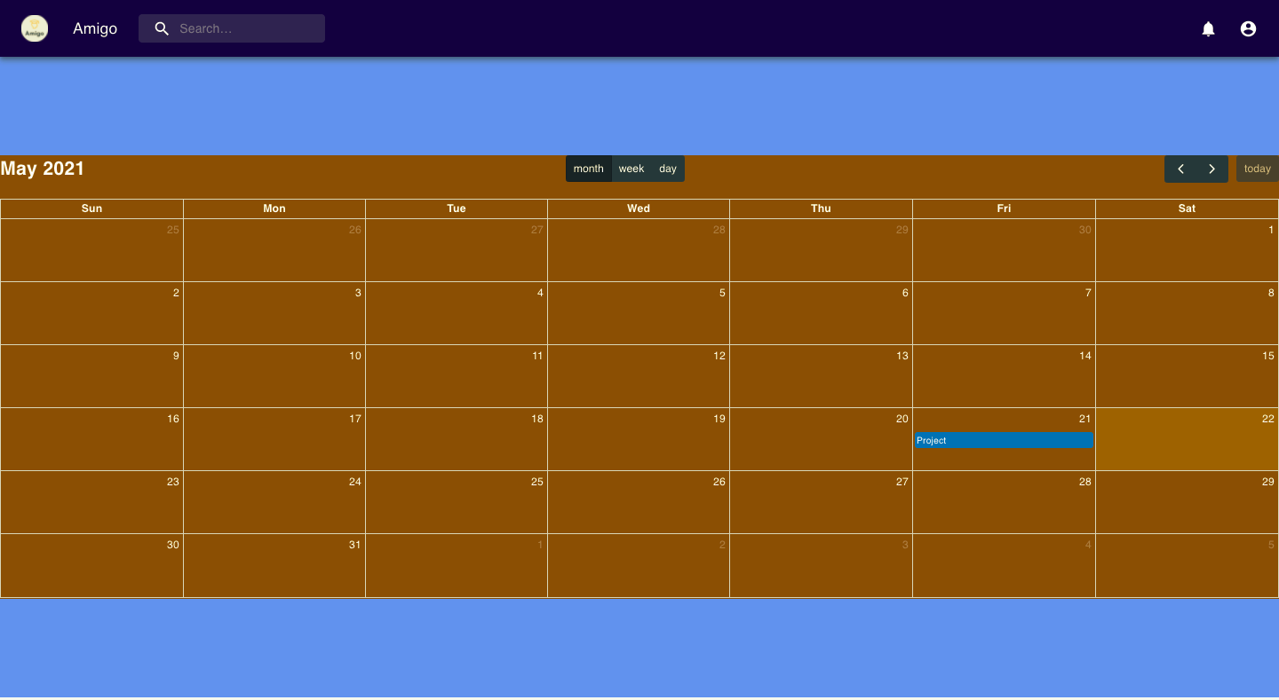

Slide 54
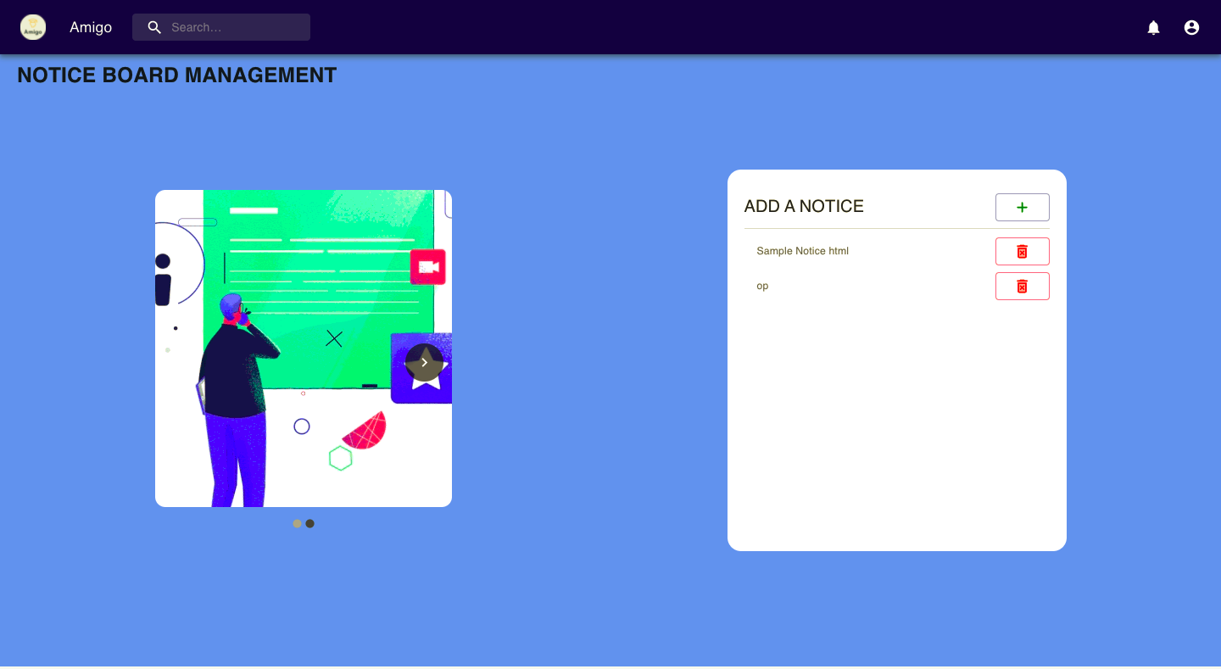

Slide 55
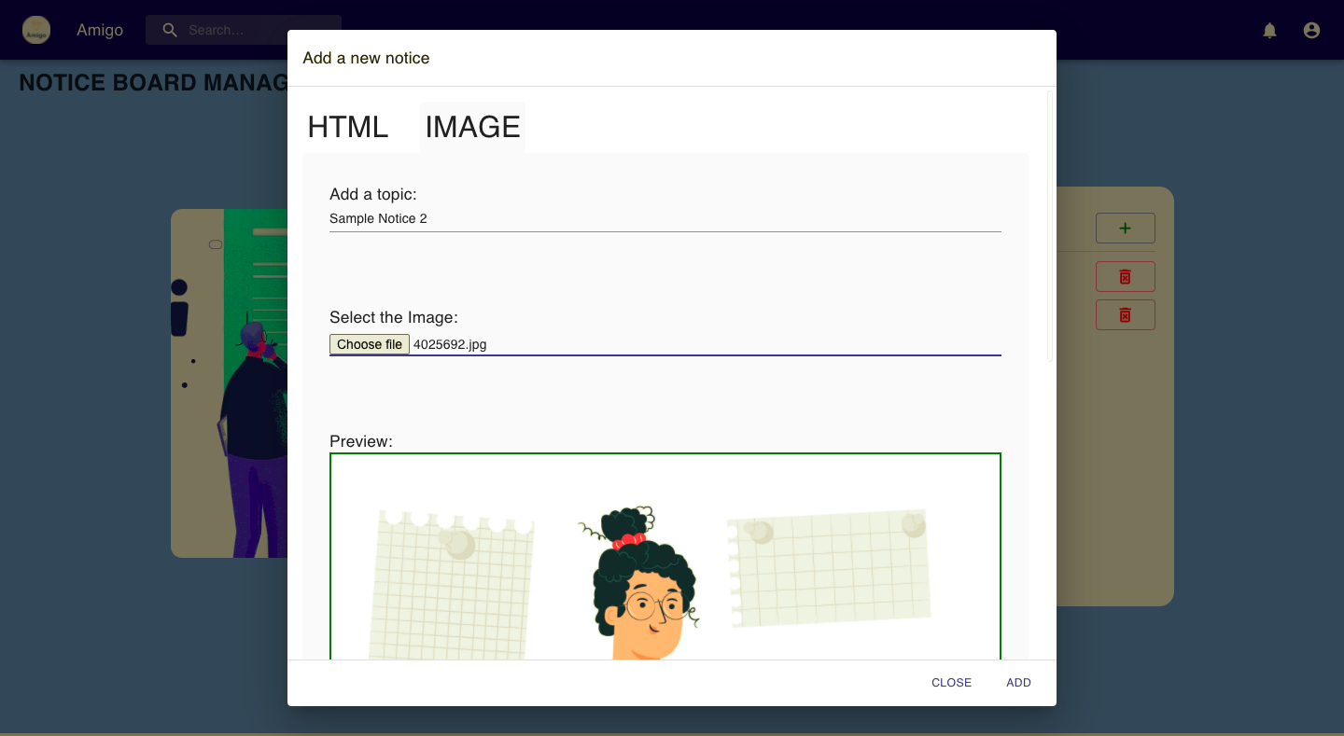

Slide 56
Modules
Module_id | Module
Mod1 | Login
Mod2 | HoD Section
Mod3 | FnA Section
Mod4 | Student Section

Slide 57
Requirements
R_ID | Requirements
R1 | Login
R2 | Calendar Display
R3 | Faculty List Management (HOD)
R4 | Course Modification (HOD)
R5 | Time Table Display
R6 | Exam Schedule Display
R7 | Notification
R8 | Manage Fees Chart (FnA)
R9 | Defaulters List Display
R10 | Fee Approval
R11 | Check Fee Status

Slide 58
Methods
M_ID | Methods
M1, M2 | input_cred(), verification()
M3, M4 | input_updated_values, update()
M5 | login_type
M6 | notification()
M7 | display()
M9 | fee_approval()
M10 | view_profile()
M11 | course_allotment()
M12 | course_modification()
M13 | manage_fee_chart()

Slide 59
TRACEABILITY MATRIX
REQUIREMENTS | USE-CASE | HIGH-LEVEL DESIGN ELEMENT | LOW LEVEL DESIGN ELEMENT
R1 | UC-1 | Mod1 | M1. M2
R2 | UC-2 | Mod4 | M7
R3 | UC-3 | Mod2 | M10, M12
R4 | UC-4 | Mod2 | M12
R5 | UC-7 | Mod4 | M7
R6 | UC-8 | Mod4 | M7
R7 | UC-11 | Mod2, Mod3, Mod4 | M6

Slide 60
TRACEABILITY MATRIX
REQUIREMENTS | USE-CASE | HIGH-LEVEL DESIGN ELEMENT | LOW LEVEL DESIGN ELEMENT
R8 | UC-13 | Mod3 | M13
R9 | UC-16 | Mod3 | M7
R10 | UC-15 | Mod3 | M9
R11 | UC-14 | Mod3, Mod4 | M7, M10

Slide 61
Test Plan
FUNCTION | INPUT | EXPECTED OUTPUT | GENERATED OUTPUT
LOGIN : USERNAME = ABC PASSWORD = 1234 CLICK ON LOGIN BUTTON | USERNAME = “ABC” PASSWORD = “123” USERNAME = “ABCD” PASSWORD = “1234” USERNAME = “ABC” PASSWORD = “1234” | “PLEASE ENTER VALID CREDENTIALS” “PLEASE ENTER VALID CREDENTIALS” “LOGIN SUCCESSFUL” | “PLEASE ENTER VALID CREDENTIALS” “PLEASE ENTER VALID CREDENTIALS” “LOGIN SUCCESSFULL”
PAYFEE : AMOUNT = REQ; CLICK ON PAY BUTTON | AMOUNT = REQ(BY DEFAULT) PAY | FEE PAYMENT SUCCESS | FEE PAYMENT SUCCESS

Slide 62
Test Plan
NOTIFY : TEXT FIELD = “REQUIRED NOTIFICATION” CLICK ON SEND BUTTON | TEXT FIELD = “TEST NOTIFY” TEXT FIELD = “TEST NOTIFY” TEXT FIELD = “TEST NOTIFY” | “NOTIFICATION SENT SUCCESSFULLY” “NOTIFICATION SENT SUCCESSFULLY” “NOTIFICATION SENT SUCCESSFULLY” | “NOTIFICATION SENT SUCCESSFULLY” “NOTIFICATION SENT SUCCESSFULLY” “NOTIFICATION SENT SUCCESSFULLY”
ALLOTCATE_COURSE : COORDINATOR = “”; COURSE=””; CODE=””; | COORDINATOR = “Triloki Pant” COURSE = “PPL” CODE = “PPL” | “COURSE ALLOCATES SUCCESSFULLY” (with change in database) | “COURSE ALLOCATED SUCCESSFULLY” (with change in database)

Slide 63
Test Plan
UPDATE_TIMETABLE CLICK ON UPLOAD BUTTON | Upload new time table | Change in time table | Time Table Changed
UPDATE_NOTICEBOARD CLICK ON UPDATE BUTTON | Upload new notice board | Change in notice board | Change in notice board
CHANGE_PASSWORD CLICK ON CHANGE PASSWORD BUTTON IN STUDENT’S PORTAL | Enter present password Enter new password | Change of password in database | Change of password in database
UPDATE_PROFILEPICTURE CLICK ON UPDATE BUTTON | Select new image Upload the image | Upload of new profile picture | Upload of new profile picture
UPLOAD_FEECHART CLICK ON UPLOAD BUTTON | Select new fee chart | Replacement of fee chart | Replacement of fee chart
SEND_FEELAERT CLICK ON ALERT BUTTON | Click on the send alert button | Alert sent to defaulters | Alert sent to defaulters

Slide 64
Test Plan
LATEFEE_TIME_EXTENSION CLICK ON CHANGE DATE BUTTON | Date Entered =’27-05-2021’ | Date extended for fee payment till ’27-05-2021’ | Date extended for fee payment till ’27-05-2021’
LATE_FEE_AMOUN_TCHANGE CLICK ON CHANGE AMOUNT BUTTON | Entered Amount = ‘200’ | Amount Changed for late fee to 200. | Amount Changed for late fee to 200.
APPLY_LATEFEE CLICK ON APPLY LATE FEE BUTTON | Click on Apply late fees | Late fees added up to the previous value of late fees for all students with due>0. | Late fees added up to the previous value of late fees for all students with due>0.
REGISTER_NEW_STUDENT CLICK ON REGISTER BUTTON | Enter Student info with enrollment number Assigned previously. Enter Student info with enrollment number that is not Assigned previously. | It won’t move to next step and no new student will be registered. It moves to next step and finally a new student is added. | It won’t move to next step and no new student will be registered. It moves to next step and finally a new student is added.
APPROVE_FEES CLICK ON APPROVE BUTTON | Clicked on Approve button | Fee Approval request disappears from the Fee Approval list and mark feeApproval attribute for that Student true. | Fee Approval request disappears from the Fee Approval list and mark feeApproval attribute for that Student true.

Slide 65
Test Plan
ADD_EVENT CLICK ON ADD BUTTON | Select Start and Ending date and set title to ‘Sample Event’ | Event gets added to DB and could be seen in the Calenders. | Event gets added to DB and could be seen in the Calenders.
ASSIGN_FACULTY CLICK ON + BUTTON and then CLICK ON COURSE | CLICK ON + BUTTON in front of faculty name and then click in the course to be allotted to. | New Assignment of teacher to course added in the table. | New Assignment of teacher to course added in the table.
ADD_NEW_COURSE CLICK ON ADD BUTTON | Add data for new course to be added and click on Add. | New Course with entered data added to the list. | New Course with entered data added to the list.
UPDATE_COURSE CLICK ON UPDATE BUTTON | Select the course to be updated. Then change the data and click on update. | The updated information reflects in the list, | The updated information reflects in the list,
DELETE_COURSE CLICK ON DELETE BUTTON | Click On delete button for the particular course. | Course is deleted from the list. | Course is deleted from the list.
UPDATE_EXAM_SCHEDULE CLICK ON UPLOAD BUTTON | Upload new exam schedule. | Change in exam schedule | Change in exam schedule
LOGOUT CLICK ON LOGOUT BUTTON | Click on the logout button | Takes you back to login page. | Takes you back to login page.

Slide 66
Link to the project
Github Link to the Project:-
https://github.com/Ayush-Khandelwal-007/Eco-system
Hosted Link to the Project:-
https://amigo-73b2a.web.app

